Slide 1
Serializers
Serializer as a synchronization mechanism to overcome the deficiency of monitors.
Serializers allow concurrency inside and thus the shared resources can be encapsulated in a serializer.
Serializers has automatic signalling
Achieved by requiring the condition for resuming the execution of waiting process to be explicitly stated when a process waits

Slide 2
Serializers are ADT defined by a set of procedures and can encapsulate the shared resource to form a protected resource object.
Only one process can access to the serializer at a time.
Procedure of a serializer may have hollow regions wherein multiple processes can be concurrently active.
When a process enters a hollow region,it releases the possession of the serializer and consequently,some other process can gain possession of the serializer.
Any number of processes can be active in a hollow region.

Slide 3
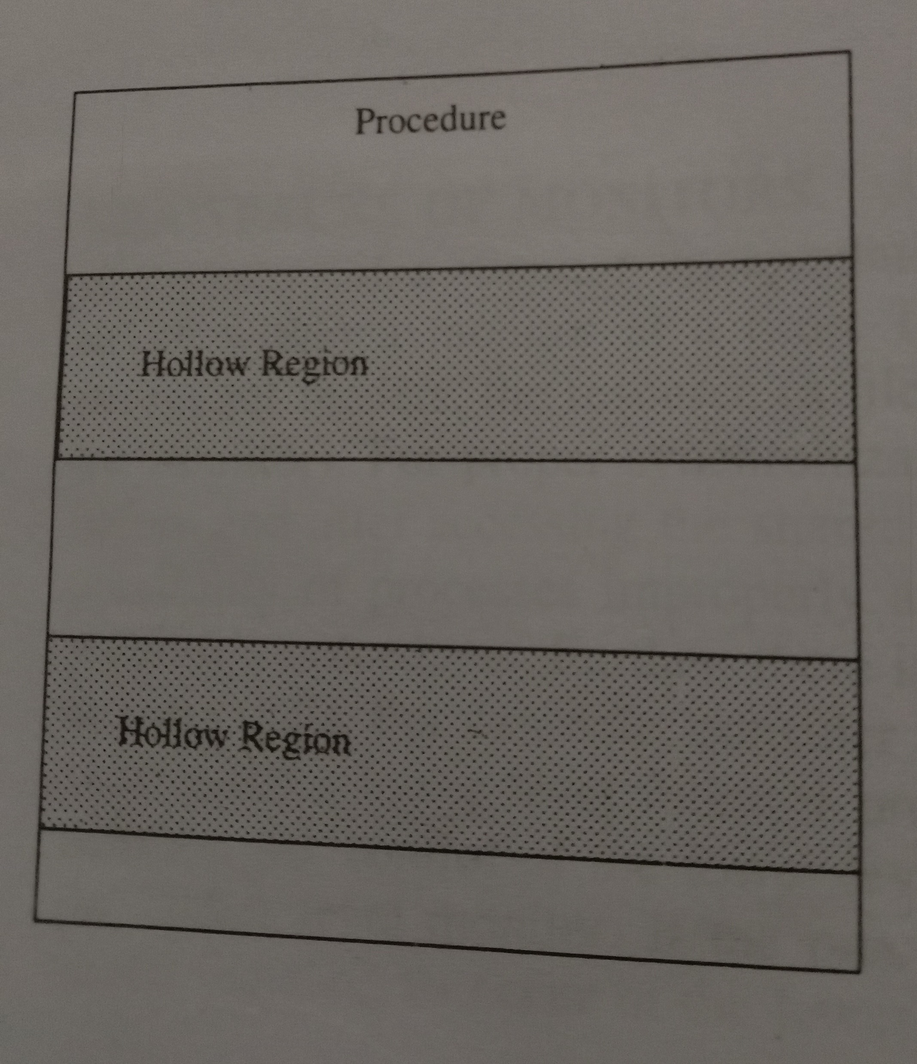
The structure of procedure of a serializer

Slide 4
A hollow region in a procedure is specified by a join-crowd operation that allows processes to access the resource while releasing the serializer,thereby allowing concurrency.
The syntax of the join crowd command is
Join-crowd(<crowd>) then <body> end.

Slide 5
On invocation of a join crowd operation possession of the serializer is released,the identity of the process invoking the join-crowd is recorded in the crowd, and the list of statements in the body is executed.
At the end of the execution of the body,a leave crowd operation is executed.

Slide 6
Queue of a serializer
Instead of condition variable in monitor,a serializer has a queue variables.
An enqueue operation,along with the condition the process is waiting for provides a delaying or blocking facility.The syntax of the enqueue command is
Enqueue(<priority>,<queue name>) until(<condition>)
Where priority specifies the priority of the process to be delayed.

Slide 7
A process invoking an enqueue is placed at an appropriate position(based on the priority) of the specified queue and the condition is not checked until the process reaches the head of the queue.
The serializer mechanism automatically restarts the process at the head of the queue when condition for which it is waiting is satisfied and no other process has control of the serializer.
No explicit signalling is needed

Slide 8
Sequence of events occurring in the use of a protected resource follows
Entry event
Establish event
Guarantee event
Join crowd event
Leave crowd event
Exit event
Time out event

Slide 9
Drawbacks of Serializer
More complex than monitor therefore less efficient.
For eg: crowd is a complex datastructure that stores identity of the process.
Also the automatic signalling feature has high overhead.

Slide 10
Path Expressions
A path expression restricts the set of admissible execution histories of the operations on the shared resource so that no incorrect state is ever reached and it indicates the order in which operations on a shared resource can be interleaved.
A path expression has the following form
path S end;
Where S denotes possible execution histories.It is an expression whose variables are the operations on the resource and whose operators are

Slide 11
Sequencing(;)
Defines a sequencing order among operations
Eg:) path open;read;close;end
No concurrency
Selection(+)
Only of the operations connected by a + operator can be executed at a time.But the order of execution of these operations does’nt matter
Eg:) path read + write end
Concurrency ({})
Signifies that any number of instances of the operations delimited by { and} can be in execution at a time.
For eg,path { read } end means any number of read operations can be executed concurrently.
The path expression path write; { read} end allows either several read operations or a single write operation can be executed at any time

Slide 12
Whenever the system is empty after all readers have finished,the writer must execute first.
Between two read one write operation should be there
Path { write;read} end means that at any time there can be any number of instantiations of the path write;read.
At any instant,the number of read operations executed is less than or equal to the number of write operations executed.
The path expression path{ write + read} end is meaningless and does not impose any restrictions on the execution of read and write operations

Slide 13
